Slide 1

Linux Instant Messenger
Chao Chen 476625

Slide 2
Overview of Project
1. Graphical user interface for Client and Server.
2. Each client can login in the IM system and send text message to others by Server.
3. Distributed servers system to improve IM server performance.
4. Asymmetric en/decryption password to guarantee the security of IM communication.

Slide 3














The Web-World’s Most Popular Communication Tools
… … … …

Slide 4
Is any body here???
Client
I am the Server, I am the one in charge of communication
How can I talk to you???
Client

Slide 5
Client/Server Model
I am the Server, I am the one in charge of communication
Client
Server
I build a static socket to make the two clients connecting to each other.
Client

Slide 6
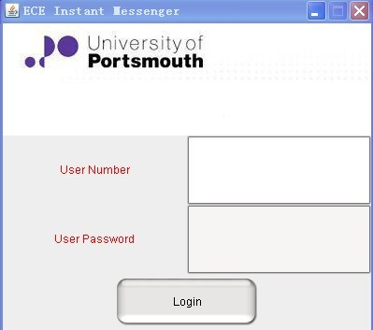
The Client Login Window
(North) JLabel (Flowlayout)
(Center)
JPanel, JLabel
JTextField,JPasswordField
(GridLayout 2,2)
(South) JButton (Flowlayout)

Slide 7
Title 1
Client 1
Client 2
Client 3
Client 4
Client 5
… … … ...
Client n
Title 2

Slide 8
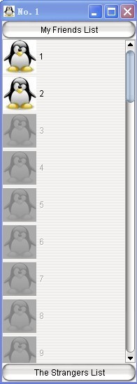
The Client Friends List
(North) JButton
(Center) JPanel, JScrollPanel
(GridLayout 50,1,5,5)
(South) JButton

Slide 9
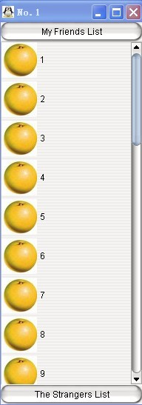
CardLayout
If click “My Friends List” button
If click “The Strangers List” button

Slide 10
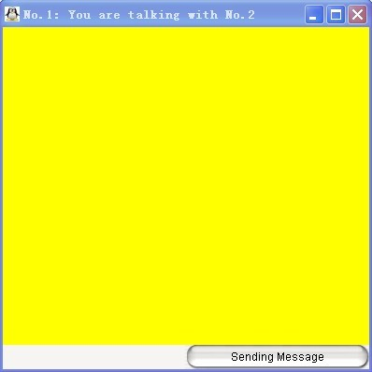
The Client Chat Window
(Center)JTextArea
(South)JPanel with JTextArea, JButton

Slide 11
A text area for presenting chat content
A text area for presenting chat content
The title
A text area for typing chat content
A button for sending
message

Slide 12
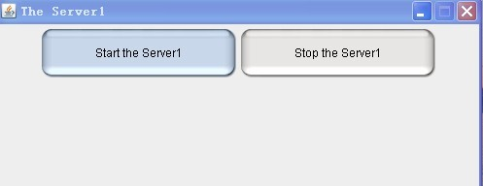
The Server Frame
JButton
JPanel

Slide 13
BufferedOutputStream
or
ObjectOutputStream ?
Client
BufferedIntputStream
or
ObjectIntputStream ?
Server
BufferedOutputStream
or
ObjectOutputStream ?
Client

Slide 14
ObjectIntputStream
socket.readObject
Client
ObjectOutputStream
socket.writeObject
ObjectOutputStream
socket.writeObject
Server
ObjectIntputStream
socket.readObject
ObjectOutputStream
socket.writeObject
ObjectIntputStream
socket.readObject
Client

Slide 15
Login System Architecture
ImClientlogin
ImFriendsList
View Layer
7
1
6
Model Layer
ImClientConServer is for connecting Server
ClientConSerThread is for keep this connection with Server
User contains userid and password
2
4
3
Server

Slide 16
ICT
ImChat is for typing and showing message
ImClientConServer is for connecting Server
ICCS
ManageClientThread is for managing these threads
CCST
IM Server
MCT
ClientConSerThread
is for keep this connection
with Server
SCCT
MIS
SerConClientThread is
for keeping this connections
with Clients
MyImServer is
for transmitting messages
Message
1.sender;
2.getter;
3.con;
4.senderTime;
ICCS
ImClientConServer
CCST
ClientConSerThread
ICT
ImChat

Slide 17
Server’s Side
ManageClientThread is for providing methods and collections stored connected threads
Sync Server
is listening
at different port
MCT
MIS
Sync Server
(serverBean)
MessageTransmitter is
for transmitting messages
SerConClientThread
MT
SerConClientThread is
for executing different commands from sync Servers and Clients
MIS
MIS
MyImServer is
for initializing Server
Sync Server
(serverBean)
Sync Server
(serverBean)
Sync Server is listening at different port
ServerManager
ServerManager is for loading Server’s configuration(server.properties)

Slide 18
Client’s Side
ServerConfig
ServerConfig is for loading
Server’s configuration(client.properties)
serverBean
serverBean
serverBean
Server object for client to choose
Message
with User and login commands
ImClientConServer is
for sending login message
ImClientLogin
ICCS
Server-Side
SerConClientThread
ManageClientConServerThread is for
managing connected thread
MCCST
CCST
ImFriendsList
ClientConSerThread
is for keeping this connection
between Server
Message
with different commands.
ImChat

Slide 19
Client
How can I address so many clients’ message transmission by a static socket ???
Client
Client
Server
……...
Client
Client
Client

Slide 20
Client
give every client a static socket and process ???
Client
Client
……...
Server
Client
Client
Client

Slide 21
Connected each client’ socket
Client
Client
Threads
Client
Server
……...
Client
Client
HashMap
Client
Manage each client’ threads for
transmitting

Slide 22
Client
What will be happened if I take a little nap?
Client
Client
Server
……...
Client
Client
Client

Slide 23
Client
???
Client
???
Client
???
……...
???
???
Client
???
Client
???
???
Client

Slide 24
Client
Server A
Client
Client
…
…
…
…
…
…
Server B
Client
Client
Server C
Client

Slide 25
Programming Model for Distributed Servers
Remote procedure call ?
Provide clients with ability to call procedures in server programs running in separate process, likely on different computers.
Remote method invocation ?
Allowing objects to invoke methods of objects that can be in different processes or computers
Event-based programming ?
- Objects can receive notifications from other possibly
remote objects about events they are interested in essentially distributed driven programming

Slide 26
Event-based Programming
(On/offline clients and text message)
Message
ServerBean/Client
notification
observer
object of interest
subscribers
Command
{ Login; Logout;
Chat; SyncServer;
… … … … }
Server/Client

Slide 27
Event-based Programming
(Client’s login or logout, text message, command)
Message
ServerBean/Client
notification
observer
object of interest
subscribers
Command
{ Login; Logout;
Chat; SyncServer;
… … … … }
Client/ServerBean

Slide 28
To store Server configuration information
XML or Properties ?
Properties : Key ---> Value
Client.properties : server’s ip address and ports
Server.properties : server’s ip address and ports

Slide 29
Client
Server A
Primary Server
Client
Client
…
…
…
…
…
…
Server B
Client
Client
Server C
Client

Slide 30
Pseudo-code
// keep serverbean in sorted order
Map serverMap <String, ServerBean> = Collections.synchronizedMap(TreeMap)
Client:
// for(forever)
for(Iterator<ServerBean> iterator = sc.iterator();iterator.hasNext();)
{
// iterate ServerBean to connect
serverbean = iteraor.next();
…
}
Server:
// for(forever)
for(Iterator<ServerBean> iter = serverManager.iteratorServerMap(); iter.hasNext();)
{
// iterate ServerBean to synchronize
serverbean = iter.next();
….
}
Ordering

Slide 31
Client
Client
Client
…
…
…
…
…
…
Server B
Primary Server
Client
Client
Server C
Client

Slide 32
Client
Client
Client
…
…
…
…
…
…
Client
Server C
Primary Server
Client
Client

Slide 33
Security ?
Client
Server A
Client
Client
…
…
…
…
…
…
Server B
Client
Client
Server C
Client

Slide 34
Symmetric En/decryption
(DES, AES…)
OR
Asymmetric En/decryption
(RSA…)

Slide 35
Client
Public Key
Server A
Client
Public Key
Client
Public Key
…
…
…
…
…
…
Public Key
Public Key
Public Key
Server B
Public Key
Client
Public Key
Client
Public Key
Server C
Client
Public Key

Slide 36
Client
Public Key
Private Key
Server A
Client
Public Key
Private Key
Client
Public Key
Private Key
…
…
…
…
…
…
Public Key
Private Key
Private Key
Public Key
Public Key
Server B
Public Key
Client
Public Key
Client
Public Key
Server C
Client
Public Key

Slide 37
Achievement so far

Slide 38

QUESTION ?

Slide 39
Connect socket timeout
Server B
Client
Client
Server C
Client
Server A
……...
Client
Server D
Client
Server E
Client

Slide 40
Server B
Client
Client
Server C
Client
Server A
……...
Client
Server D
Client
Server E
Client

Slide 41
Server B
Client
Client
Server C
Client
Server A
……...
Client
Server D
Client
Server E
Client

Slide 42
Server B
Client
Client
Server C
Client
……...
Client
Server D
Client
Server E
Connect socket timeout
Client

Slide 43
Client
Client
Server C
Client
……...
Client
Server D
Client
Server E
Client

Slide 44
Client
Client
Client
……...
Client
Server D
Client
Server E
Client

Slide 45
Server B
Client
Client
Server C
Client
Server A
……...
Client
Server D
Client
Server E
Client

Slide 46
Server B
Client
Public Key
Client
Public Key
Server C
Client
Public Key
Server A
……...
Public Key
Public Key
Client
Server D
Public Key
Public Key
Client
Server E
Public Key
Client

Slide 47
Server B
Client
Public Key
Client
Public Key
Server C
Client
Private Key
Public Key
Server A
……...
Public Key
Public Key
Client
Server D
Public Key
Public Key
Client
Server E
Public Key
Client

Slide 48
Server B
Client
Public Key
Private Key
Client
Private Key
Public Key
Server C
Client
Private Key
Public Key
Server A
Private Key
……...
Public Key
Public Key
Private Key
Client
Server D
Public Key
Public Key
Client
Private Key
Server E
Public Key
Private Key
Client

